Slide 1
Tracking Rules and their Supporting Documents
Presented by Dhruti Bhagat
Librarian, HQ & Chemical Libraries
(ASMS Contractor)
Notes:
Thank you everyone for coming, today we will be talking about finding rules, rule histories and their supporting documents.
Windows to have open: Fdsys, HeinOnline, NTRL, LOC, Regulations.gov, Library catalog, NSCEP

Slide 2
What is a rule or regulation?
Rules are known as administrative law, but they go through a different process than congressional laws. A rule allows an executive agency to regulate certain industries, activities, or products.
For an executive agency to have this power, a law is created by congress, which gives the agency (like EPA) the ability to make and carry out rules or regulations that fulfill the intent of the law
Most rules are developed through a rule-making process, which includes public comment on the proposed rule, and the addition of supporting documents into the rule’s docket folder.
Notes:
First, I want to make sure we’re all on the same page, so I’m just going to quickly go over what a rule is.
After #2:
For example, the CAA doesn’t contain specifics on how many tons of Epichlorohydrin an Epoxy Resin manufacturer can emit, but it does list Epichlorohydrin (a by-product of that industry) as a hazardous air pollutant. That law allows EPA to look into the situation and make a determination on how much of this pollutant should be allowed in the air, and from there, regulate how many tons of Epichlorohydrin an Epoxy Resin manufacture can emit.
#3

Slide 3
What are the different steps a rule takes before it is final?
There are many different steps a rule can take before a rule is finalized, and there are a few it can take after it is finalized as well.
A rule can take any number of these following steps: Advanced Notice of Proposed Rulemaking, Proposed Rule*, Comment Period*, Extension of Comment Period, Final Rule*, Direct Final Rule, Amendments to the Final Rule, Notice of Reconsideration, Withdrawal of Final Rule, Interim Final Rule, etc.
*= Required step in the process
Notes:
I’m not going to go into every possible step, because there are a lot and there are a lot of nuances, but I will describe the more important type of steps, so that you understand how the process works, if you’re not already familiar.
Now, I’ll go into what each of these mean.

Slide 4
What does each step mean?
Advanced Notice of Proposed Rulemaking- When an agency is in the preliminary stages of the rulemaking process, it may submit one of these in the Federal Register to get more information from the public on the potential rule, before they submit their proposed rule.
*Proposed Rule – This is the document that states the agency’s plans to address a problem or achieve a goal. At this point, the rule is open to public comment. This is a required step.
During the comment period, members of the public can submit comments or documents relating to the proposed rule. These items end up in the rule’s docket folder. The agency itself might also add documents into the folder, such as regulatory impact analyses and background information documents.
Notes:
After #1, like epichlorohydrin if they weren’t sure…

Slide 5
What does each step mean?
*Final Rule – This is the final and official version of the rule. This rule will likely have some changes from the proposed rule, due to public comments, and the rulemaking will address some of the comments. At the end of the published version in the Federal Register, it will detail how it will amend the Code of Federal Regulations (CFR).
Sometimes agencies don’t anticipate any adverse comments, so they will publish a Proposed Rule and a Direct Final Rule together; these rules are identical, but can still be commented on.
However, after a rule is published, sometimes the Agency gets additional adverse comments or information, and will publish a Withdrawal of the Final Rule, in which they revoke the published rule. When this happens, they can, but don’t always, publish an Interim or Temporary Final Rule in its place.
Notes:
The interim rule keeps some provisions in place while the agency reconsiders its ruling.

Slide 6
Questions?
We just reviewed:
What a rule/regulation is
The steps a rule takes before becoming final
The definitions and meanings of each step

Slide 7
How do I find rules and notices?
For rules from 1990- present, you can find them on FDsys (a Government Publishing Office site) : https://www.gpo.gov/fdsys/.
For all rules, you can use HeinOnline: http://www.heinonline.org/HOL/Welcome.
Or Library of Congress’s Federal Register collection: https://www.loc.gov/collections/federal-register/, which is free, for use with public patrons (1900-1999)
The rule can be found in the docket folder in regulations.gov: https://www.regulations.gov/ (~2003-present).
Notes:
Now we will move on to demonstrating how to find these in each of the databases

Slide 8
Finding the rule in FDsys
In FDsys, you can search by title, browse by date, or enter in a citation for the Federal Register. You can only do this for rules published 1990-current.
For the Federal Register issues published between 1990-1993, each issue is digitized as a PDF, and not broken down by agency or rule like later issues are.
Notes:
For these databases, I’ll talk first and then demonstrate some of it, so you can see it.
Do demonstration of finding rule 80 FR 33100 (June 10, 2015), Renewable Fuel Standard Program:
Standards for 2014, 2015, and 2016 and Biomass-Based Diesel Volume for 2017.
Show earlier rules (1991) compare to later (2002).

Slide 9
Finding the rule in HeinOnline
For all rules you can search in HeinOnline by citation or you can browse by publication date. HeinOnline has all past federal register volumes, but sometimes there is a lag in publication of issues in the current volume.
Notes:
Do demonstration of finding rule 80 FR 33100 (June 10, 2015), Renewable Fuel Standard Program:
Standards for 2014, 2015, and 2016 and Biomass-Based Diesel Volume for 2017.
Also demonstrate browse
Can try searching by rule title, but search isn’t great.

Slide 10
Finding the rule in the Library of Congress’ Federal Register collection
In the Library of Congress collection, you can search the collection up at the top, or narrow down by facets on the side.
Notes:
This collection LOC got from HeinOnline, but they just got the PDFs, so they don’t have anything indexed. You can’t search by citation for this reason.
Do demonstration of finding notice 54 FR 41566 National Oil and Hazardous Substance Pollution Contingency Plan: Applicability of RCRA Land Disposal Restrictions to CERCLA Response Actions. October 10, 1989. Search Oct. 10, 1989.
This search is not great either, and each day is a single PDF. Search by date. Look through table of contents to find the right page number and scroll until you find it. P. 146.
Bookmark a particular page: #page=page number

Slide 11
Finding the rule in regulations.gov
In regulations.gov, for rules from 2003- present, the rule(s) should be in the docket folder. You will need the docket number or rule name to search.
Notes:
The rules themselves aren’t indexed, so you also can’t search by citation here.
Do demonstration of finding rule 80 FR 33100 (June 10, 2015), Renewable Fuel Standard Program:
Standards for 2014, 2015, and 2016 and Biomass-Based Diesel Volume for 2017.
At first it will say 0, but wait for the results. Then go to the docket folder, click on the rule we want, and then the PDF.
The other way to search is by docket number, which I’ll show you in a a few minutes.

Slide 12
Questions?
We just reviewed:
How to find rules in FDsys, HeinOnline, Library of Congress, and Regulations.gov

Slide 13
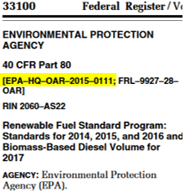
Finding the rule history
If you’re trying to trace the history of a rule, start with regulations.gov. Even if your rule wasn’t promulgated after 2003, it might still be in there. If you can, locate the docket number.
The docket number can be found at the top of any notice, proposed rule, or final rule. This is the key to helping you find the information you need in regulations.gov. Prior to 2002, the docket numbers are sequenced a little differently, so they won’t look like this.
Notes:
You can also search by rule title in addition to docket number
Show older docket number from 50 FR 5862
FRL-2671-8
Next, I’ll show you how to find it in Regulations.gov. Next slide.

Slide 14
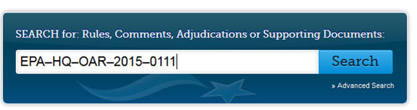
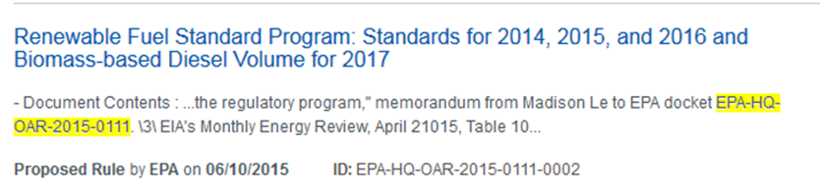
Finding the rule history in regulations.gov
You can search by docket number, or by rule name, but searching by docket number is the best way to do this in this database.
Once you have the docket number, enter it into the search bar on the website.
One of the first search results should be from that docket folder. When you find a relevant result, click on it.
Then click on “Open Docket Folder”
Notes:
Best bet for older rules, is to try searching by docket number and then rule name, if that doesn’t work. Be careful, sometimes multiple dockets with similar names.
FRL-2671-8 “National Oil and Hazardous Substances Pollution Contingency Plan.” 50 FR 5862 February 12, 1985 Proposed Rule.
EPA-HQ-OAR-2015-0111

Slide 15
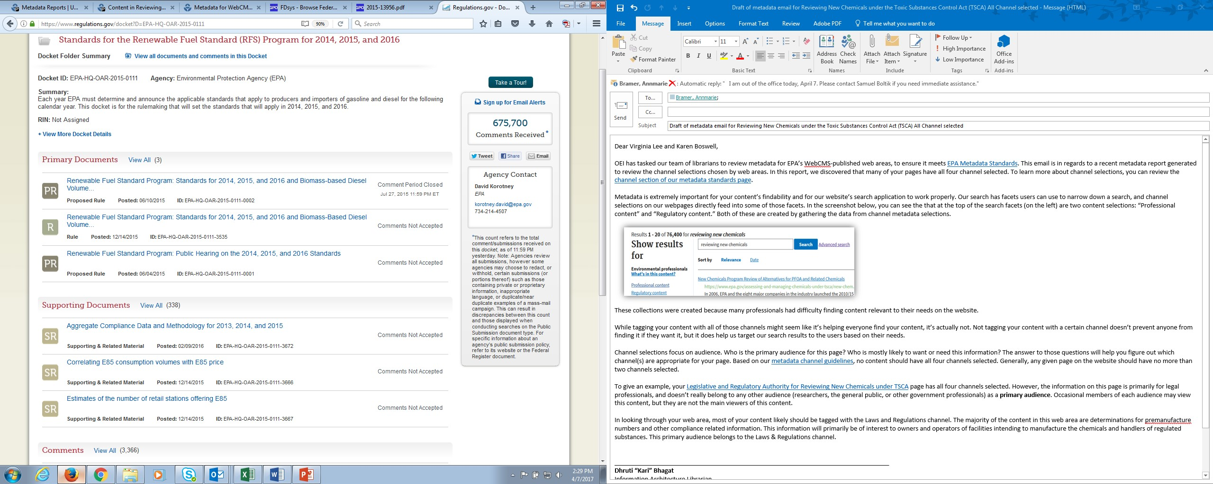
Docket folder in regulations.gov
Notes:
At the top of the docket folder, it will show a section for Primary Documents. These are notices, proposed rules, final rules, etc. that are published in the federal register. For rules promulgated after 2003, all of the rule history should be in here. At the top right you can also sign up for email alerts.
If you have an older rule, the complete rule history may not be in here, so you should try to double check other sources, if you can.
We can also see supporting documents (which we will get back to soon). And we can see the comments on the rule on this page.

Slide 16
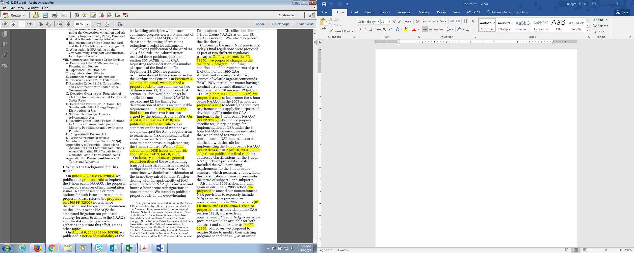
Looking for mentions of the proposed rule
Notes:
If the rule history isn’t in regulations.gov, then you can look through your rule for any mentions of the proposed rule, or previous steps, which will usually come with a citation. From there, you can find the previous steps, like the proposed rule, and see if that proposed rule cites any previous notices or proposed rules, to try and reconstruct the rule history. It’s pretty tedious, and not ideal.

Slide 17
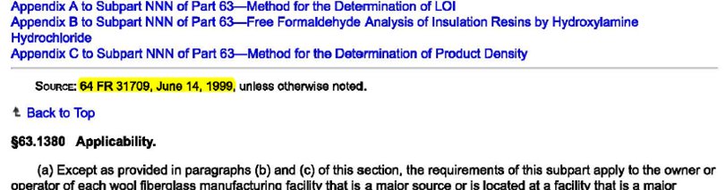
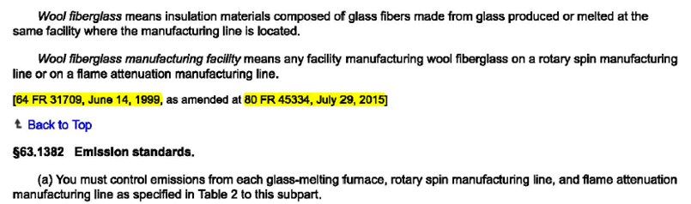
Using the CFR to find the rule history
Notes:
Or, instead of looking through your rule, you can try to look through the Code of Federal Regulations (CFR) section to find the citations of rules that amended it. These rule citations will only be final rules, so you’ll have to look through those rules to find proposed rules, if you need them.
This method also isn’t very precise, it won’t catch everything, and you will probably have multiple docket folders to separate out, if you’re only trying to track one docket.

Slide 18
Questions?
We just reviewed:
Finding the rule history using the docket number in regulations.gov
Locating the docket folder in regulations.gov
Using the text of a rule to find its history
Using the Code of Federal Regulations to find the rule history

Slide 19
Finding supporting documents to the rule
Regulations.gov is the best place to look for supporting documents. Anything after 2003 should be there.
01
Many supporting documents are available in the National Technical Reports Library (NTRL)
02
Lastly, documents not available in NTRL may be in the library’s collections on microfiche
03

Slide 20
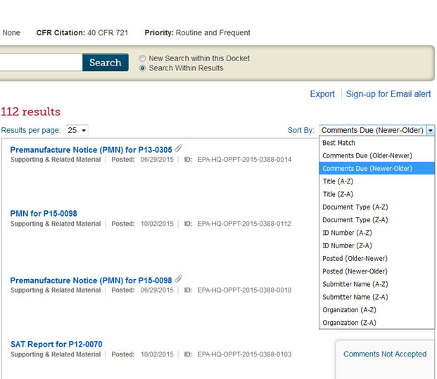
Finding supporting documents in regulations.gov
Back in the docket folder, underneath primary documents is a section called “supporting documents.” These are the documents submitted by EPA, contractors, and concerned citizens in response to the rule making process.
Notes:
Click on “View all” and you can sort by various methods, as well as search for your document with title or keywords.
Search “Analysis of historical errors” … in projections of gasoline and distillate demand from EIA
Make sure to change the “sort by” drop down

Slide 21
Finding supporting documents not in regulations.gov
Once you have the document name, or EPA document number (if applicable) you can try searching NSCEP, to see if something comes up.
If it doesn’t, you can try directly searching NTRL, or searching the National Library Catalog.
In NTRL your document may have already been scanned, which means it is available to download as a PDF.
However, NTRL nay not have the document scanned, but it will provide you with the PB number. You can use this to search the National Library Catalog.
The catalog will also tell you the PB number of the document if it is available, which you can use to search NTRL, and it will tell you if there are any physical copies of it in EPA’s network.
Notes:
I’ll show an example of these steps coming up, so don’t worry too much about getting this all down now. There are a couple of options for the steps you can take, so it may seem a little confusing right now, but hopefully it won’t in a minute.

Slide 22
For example: finding supporting documents
We are going to try to find this document “Economic Impact Analysis of Effluent Limitations Guidelines and Standards for the Organic Chemicals, Plastics, and Synthetic Fibers Industry.”
We know it was published in the mid- late 1980s
We were also given the EPA document number 400/2-87/007
Notes:
First, we would search NSCEP with document number, but searching by title probably won’t work.
If we didn’t find it, we would look in regulations.gov and search by document title. (make sure you click supporting material): https://www.regulations.gov/document?D=EPA-HQ-OW-2002-0025-2133 – looks like we got the EPA # wrong (which happens), so we search NSCEP again. However, this document is missing some stuff, as you can see page 1 is missing.
Then we check the library catalog we can:
See a new document number and re-search NSCEP
Use the PB number here and search NTRL
Go directly to the microfiche
Now we, go to NTRL. We could have skipped the library catalog step, but I wanted to show you the different possibilities. Search by title or PB number. Unfortunately it is not available as a PDF here, so we have to find it on microfiche in our library.

Slide 23
Questions?
Contact Information:
Kari Bhagat
Librarian, Headquarters & Chemical Libraries
Bhagat.Dhruti@epa.gov , 202-564-8628
Arctic Slope Mission Services Contractor

